Slide 1
Youtube Tool
Rizwanulla Mohammed (Riz)

Slide 2
Team Idea
Tool is a form with 2 fields (location and interests).
Given the input, information will be pulled from database and used to make a prediction.
USER
User interacts with the tool
Tool displays info
Database sends the information back to the tool.
TOOL
Tool sends data request info to the database
DATABASE
Notes:
Slide 1: General design and architecture of the tool

Slide 3
Story/Architecture of contribution
Writing an algorithm to make a prediction given the inputs from the user
Input: location and interest (category)
Used a linear regression equation
Simple way to model relationship between two sets of variables.
Values used: Views per video and subscribers per video
Created Video, Location, and User objects
Notes:
Slide 1: General design and architecture of the tool

Slide 4
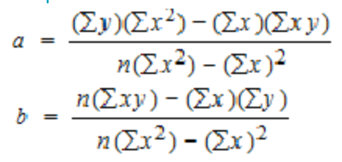
DEMO
Y = a + bx
x = subscribers
y = views

Slide 5
What to do next
Change prediction:
Currently: linear regression equation looking at the 2 values in the dataset.
Future: a model that uses more values in the data set like video length.
Will help make more accurate predictions
Update Form to handle more complex data
Currently: a form with 2 dropdown menus
Future: allow more specific information like, genre in music, tutorial, demo, technical, etc.
Helps prune the data to grab more specific data values to build models on
Will help retrieve more relevant data
Update the location object:
Currently: an object with a list of all the video objects given a location
Future: Make all location values a field in the Video object.
Will help save space by not repeating work
Notes:
Slide 3: Component that I built, and what I was aiming for

